Slide 1
Using human behavior to
understand monkey physiology
Dan Birman
2016-02-16
Frisem

Slide 2
What is it like to be a monkey?

Slide 3
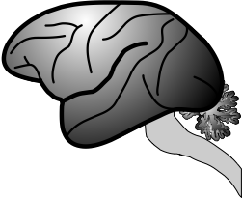
What is it like to be a monkey?

Slide 4
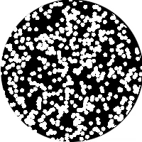
What is it like to be a monkey?

Slide 5
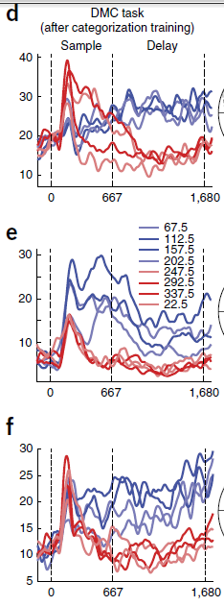
What is it like to be a monkey?

Slide 6
What is it like to be a monkey?

Slide 7
What is it like to be a monkey?

Slide 8
What is it like to be a monkey?
prospective student

Slide 9


Slide 10
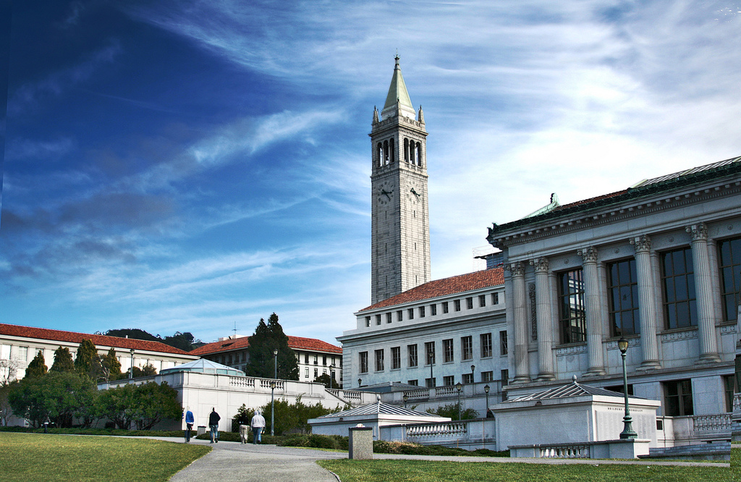

Slide 11
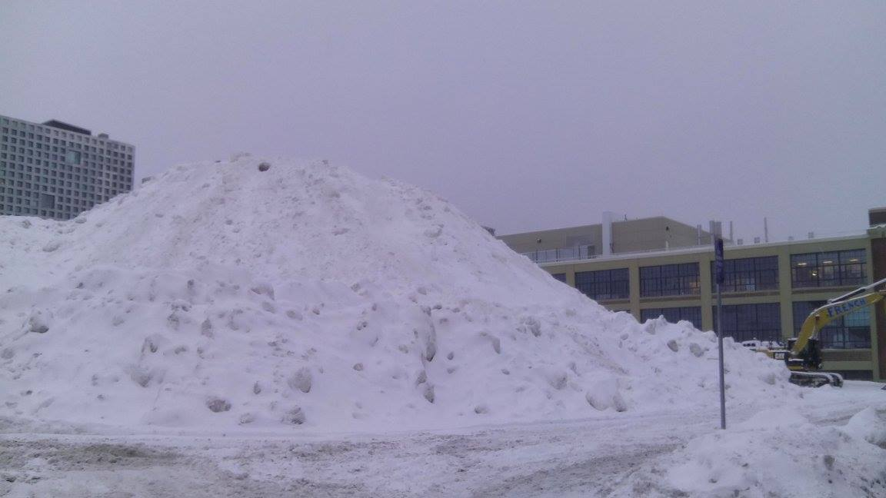

Slide 12



Slide 13
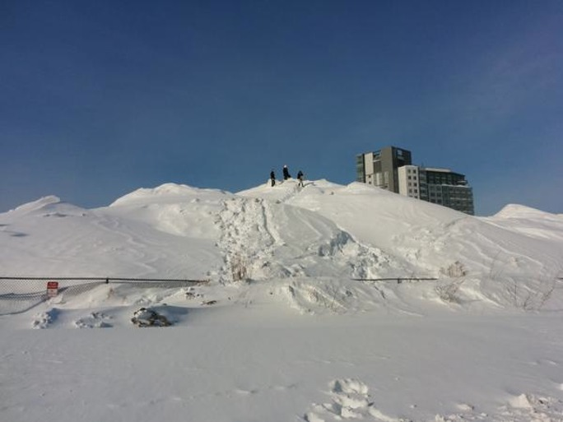

Slide 14
Criteria: Weather

Slide 15
Criteria: Weather
but also
Geography…

Slide 17
Criteria: # of Faculty

Slide 18
Criteria: In the US?

Slide 19




What is it like to be a monkey?
prospective student

Slide 20
What is it like to be a monkey?
prospective student

Slide 21
What is it like to be a monkey?
prospective student

Slide 22
What is it like to be a monkey?
prospective student

Slide 23
What is it like to be a monkey?
prospective student

Slide 24
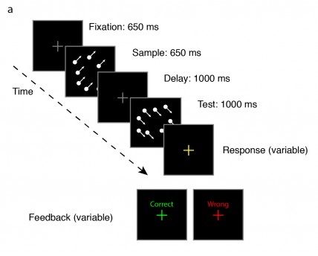

Slide 25
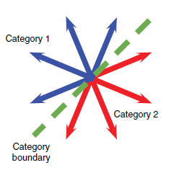

Slide 26
Categorization

Slide 27
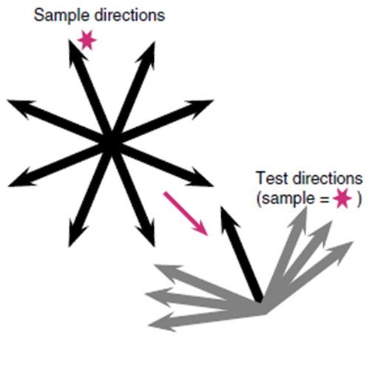
Categorization

Slide 28
Match to
Sample
Categorization

Slide 29
What is it like to be a monkey?

Slide 30
What is it like to be a …
monkey LIP neuron
doing categorization?

Slide 32
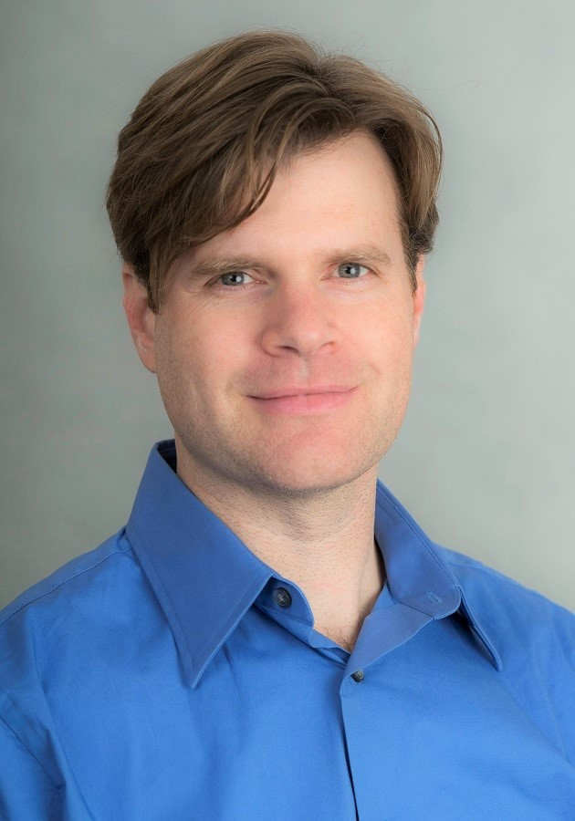

Arup Sarma, Nick Masse, X Wang, David Freedman @ U Chicago
David Freedman
Nick Masse

Slide 35
Sarma et al. 2016

Slide 40
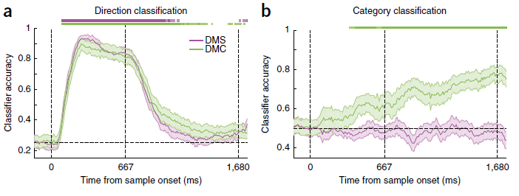

Slide 42
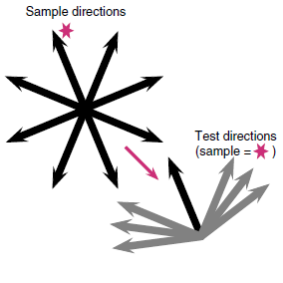
Sarma et al. 2016

Slide 43
What is it like to be a …
monkey LIP neuron
doing sample matching?

Slide 44
Sarma et al. 2016

Slide 45
Sarma et al. 2016

Slide 46
Sarma et al. 2016

Slide 47
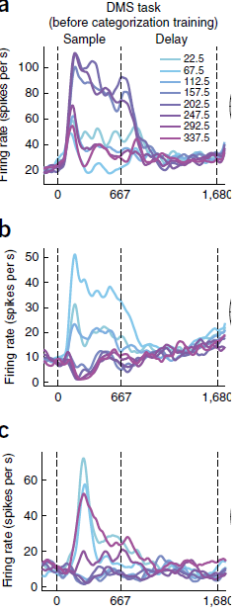

Slide 50

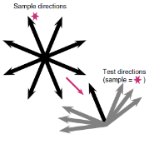
Match to Category
Match to Sample

Slide 51
What is it like to be a
monkey LIP neuron?

Slide 52
What is it like to be a
monkey LIP neuron?

Slide 53
What is it like to be a
monkey LIP neuron?

Slide 54


What is it like to be a
monkey LIP neuron?

Slide 55
What is it like to be a
monkey doing this task?

Slide 56
What is it like to be a
monkey doing this task?
human

Slide 57
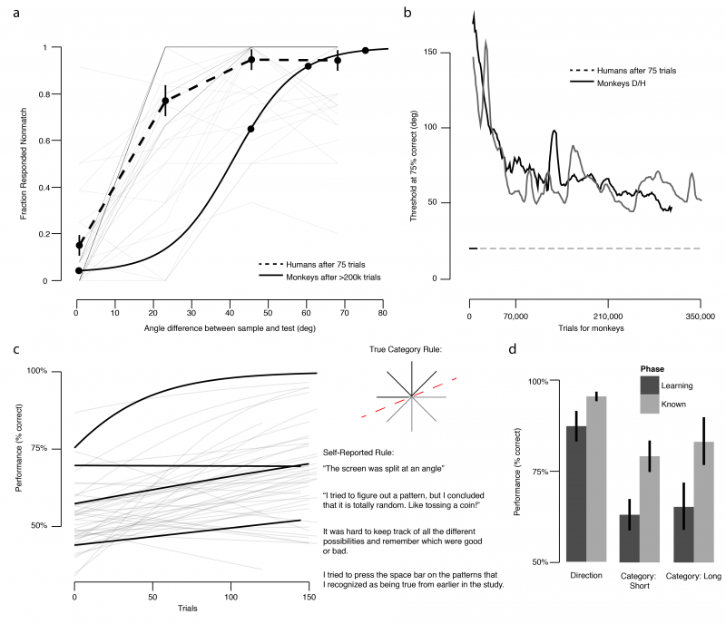

Slide 59
Threshold
~75% correct

Slide 69
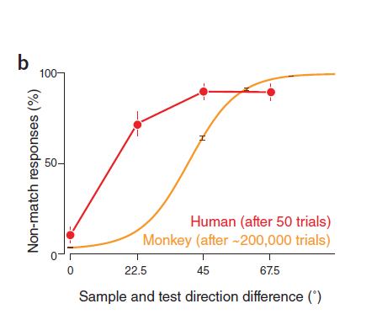
Birman & Gardner, Nat Neuro (2015)

Slide 70
Birman & Gardner, Nat Neuro (2015)

Slide 71
Birman & Gardner, Nat Neuro (2015)

Slide 72
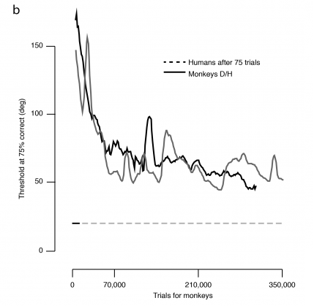

Slide 74
Human Performance (75 trials)

Slide 76
What is it like to be a
monkey doing this task?

Slide 77
What is it like to be a
monkey doing this task?

Slide 78
What is it like to be a
monkey doing this task?

Slide 79
What is it like to be a
monkey doing this task?

Slide 80
What is it like to be a
monkey doing this task?
Human behavioral data
can give us some insight…

Slide 81

Thank you!
Justin Gardner
Freedman Lab @ U Chicago
Nick Masse
David Freedman

